Slide 1

Introduction to Data Analytics — Sprint 2 Business analysis of Adventure Works
James Davies
14 September 2023

Slide 2
Contents
1 Overview of company performance
2 Sales by segment
3 Logistics and human resources
4 Conclusions and recommendations

Slide 3
1
Overview of company performance

Slide 4
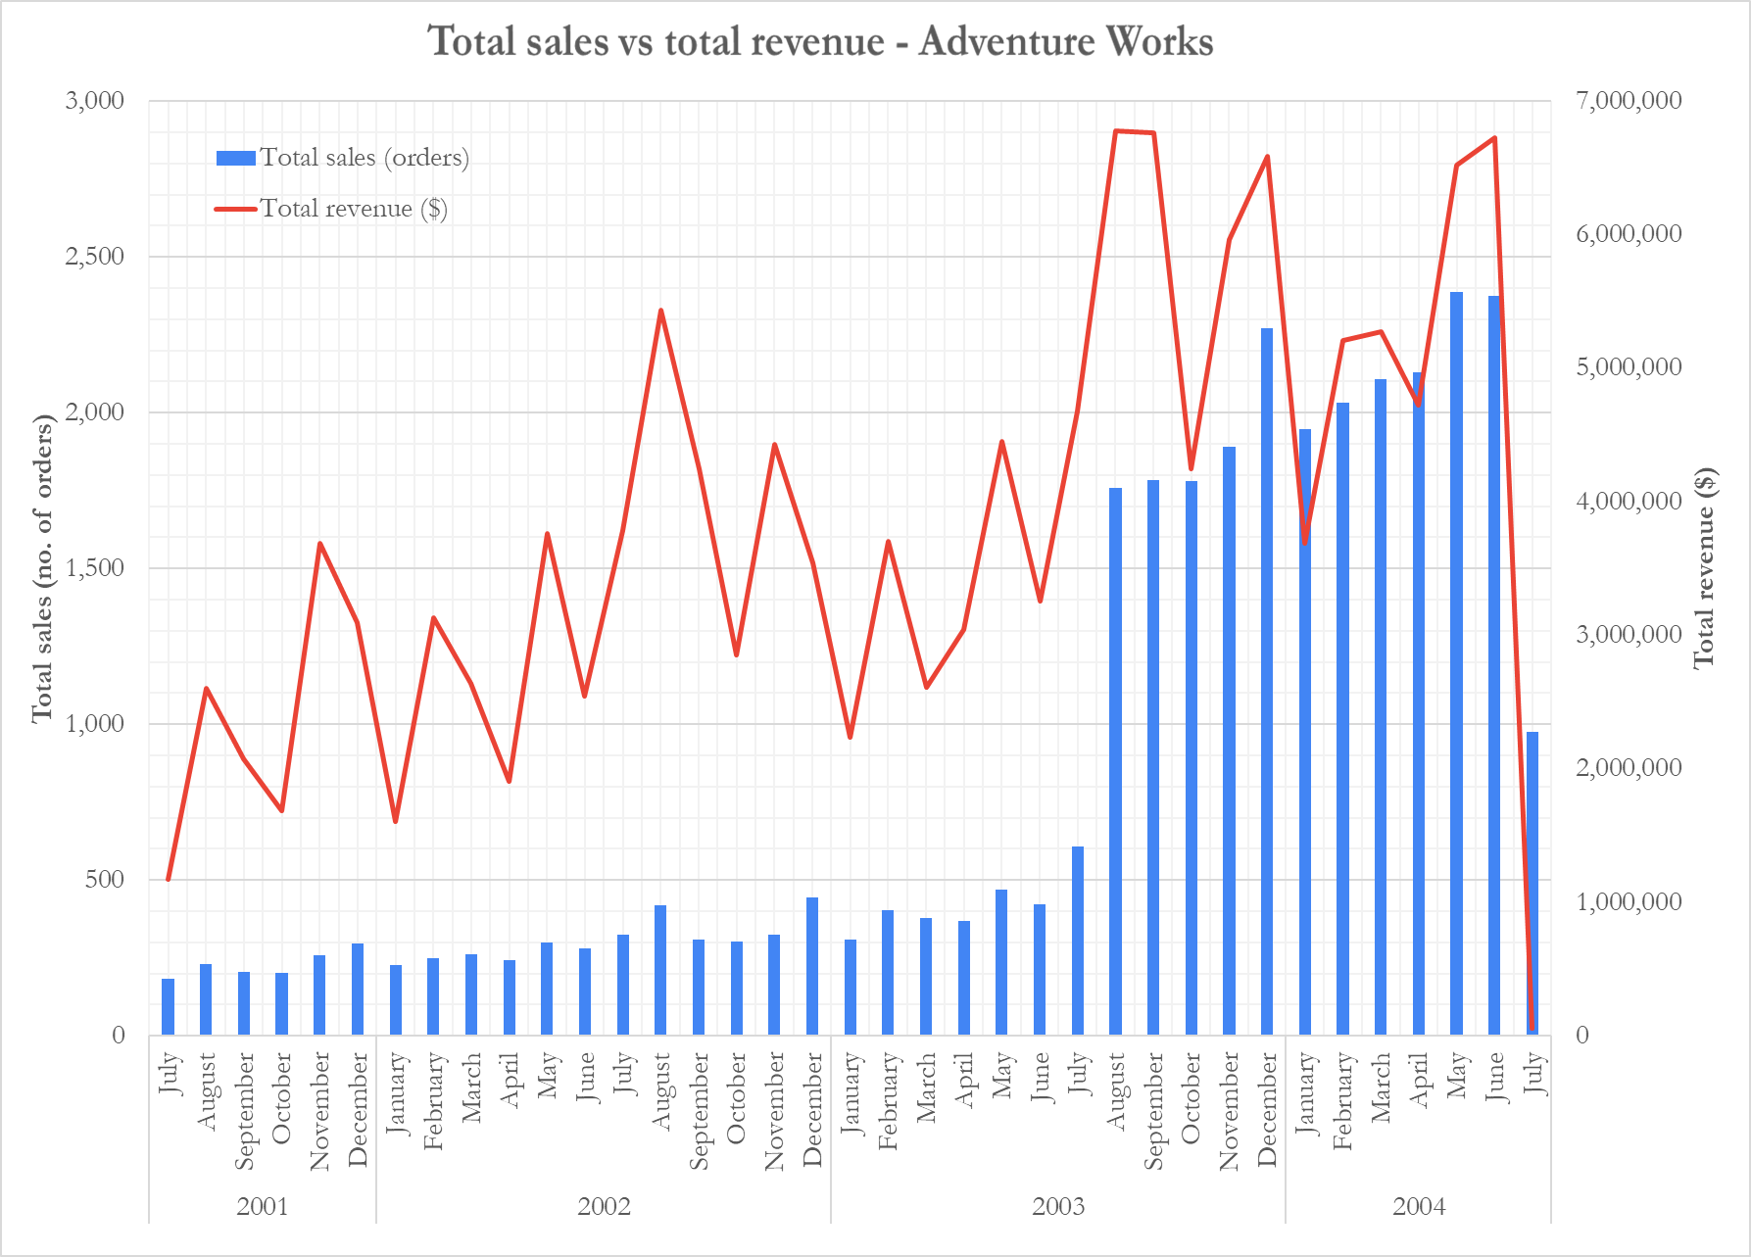
Dramatic sales increase and noticeable revenue increase from mid-2003
Total sales jumped nearly three-fold from 609 in July 2003 to 1,760 in August 2003; revenue increased from US$4.68 million to US$6.78 million in the same two-month period.
Phase 1: Low sales volume and relatively low revenue
Phase 2: Dramatic increase in sales; average revenue higher than pre-July 2003.
Phase 3: Revenue plummets by >99% in July 2004; sales fall by over half
Chart 1. Total sales (orders) and total revenue ($US) across all regions of Adventure Works. Each phase represents my interpretation of a notable and/or sustained change in total sales and revenue. (Source: Internal data from Adventure Works, 2001-2004)
James Davies | Introduction to Data Analytics — Sprint 2: Business analysis of Adventure Works
3

Slide 5
Dramatic sales increase and noticeable revenue increase from mid-2003
Phase 1
Phase 1:
Phase 2
Phase 3
Chart 1. Total sales (orders) and total revenue ($US) across all regions of Adventure Works. Each phase represents my interpretation of a notable and/or sustained change in total sales and revenue. (Source: Internal data from Adventure Works, 2001-2004.)
Phase 2 shows higher sales in all months (see green cells) relative to Phase 1, and higher revenue in most months.
Phase 2
Phase 3 shows a sharp reduction in sales and revenue. (It is unclear what may have caused this.)
Chart 2. Total sales (orders) and total revenue ($US) across all regions of Adventure Works. Green cells indicate figures above the 66th percentile, while red cells indicate figures below the 33rd percentile. (Source: Internal data from Adventure Works, 2001-2004.)
James Davies | Introduction to Data Analytics — Sprint 2: Business analysis of Adventure Works
4

Slide 6
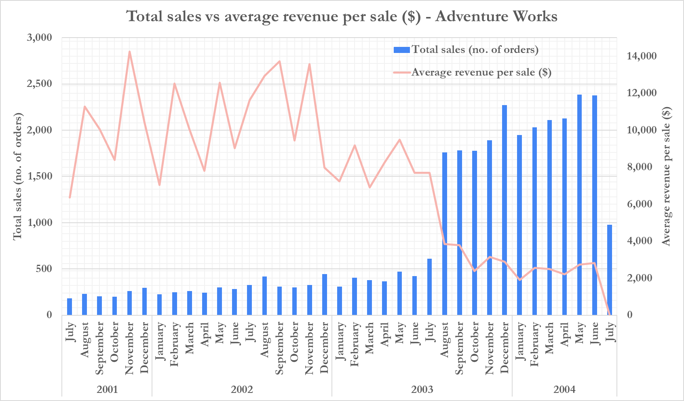
Sales increase due to price cut; revenue per sale falls >50% from mid-2003
Between July and August 2003, the boundary between Phase 1 and Phase 2, average revenue per sale falls from US$7,687 to US$3,850. By the first six months of 2004, average revenue per sale declined further, to an average of US$2,458 (excluding July 2004; see red bars in Chart 3).
Phase 1
This suggests that either different (cheaper) products were being sold in Phase 2, or that Adventure Works cut its prices.
Phase 2
Phase 1
Phase 2
Phase 3
Phase 3
Chart 4. Total sales (orders) and total revenue ($US) across all regions of Adventure Works. (Source: Internal data from Adventure Works, 2001-2004.)
Chart 3. Total sales (orders) and average revenue ($US) per sale across all regions of Adventure Works. Green bars indicate figures above the 59th percentile, while red bars indicate figures below the 30th percentile. (Source: Internal data from Adventure Works, 2001-2004.)
James Davies | Introduction to Data Analytics — Sprint 2: Business analysis of Adventure Works
5

Slide 7
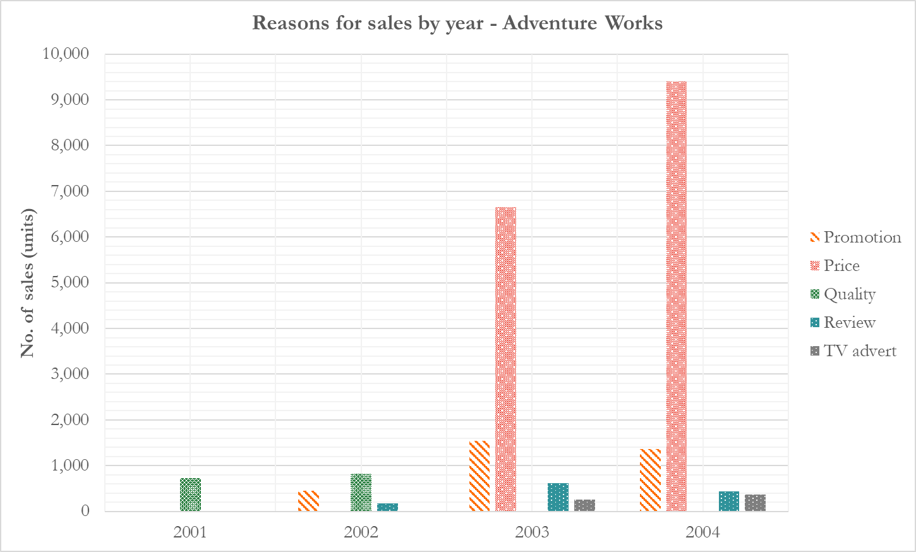
Sales survey suggests price is the primary reason for sales in 2003 and 2004
In 2001 and 2002, ‘Quality’ was cited as the most popular reason for a purchase (727 and 824 sales, respectively; see Chart 6). However, in both years the majority of sales had no reason attached, so the data may not give the full picture).
In 2003 and 2004, ‘Price’ was cited as by far the most popular reason for a purchase (6,653 and 9,397 sales, respectively; see Chart 6), with ‘Quality’ not recorded in either year. Although these results may not be truly representative (see the number of ‘Other/unstated reason’ sales in Chart 6), it strongly suggests that Adventure Works used price as a major component of their strategy from August 2003 onwards, which coincides with the ~50% fall in revenue per sale at the beginning of Phase 2 (see Chart 4).
Phase 1
Phase 2
Chart 4. Total sales (orders) and total revenue ($US) across all regions of Adventure Works. (Source: Internal data from Adventure Works, 2001-2004.)
Chart 6. Reasons for sale across all regions for all years at Adventure Works. Green cells represent the most popular reason for that year. Note: the data from 2001 and 2004 show only July-December and January-July, respectively. Where no reason for a sale was given, that sale was counted in the ‘Other/unstated reason’ row. (Source: Internal data from Adventure Works, 2001-2004.)
Chart 5. Reasons for sale across all regions for all years at Adventure Works (a visual representation of Chart 6). (Source: Internal data from Adventure Works, 2001-2004.)
James Davies | Introduction to Data Analytics — Sprint 2: Business analysis of Adventure Works
6

Slide 8
2
Sales by segment

Slide 9
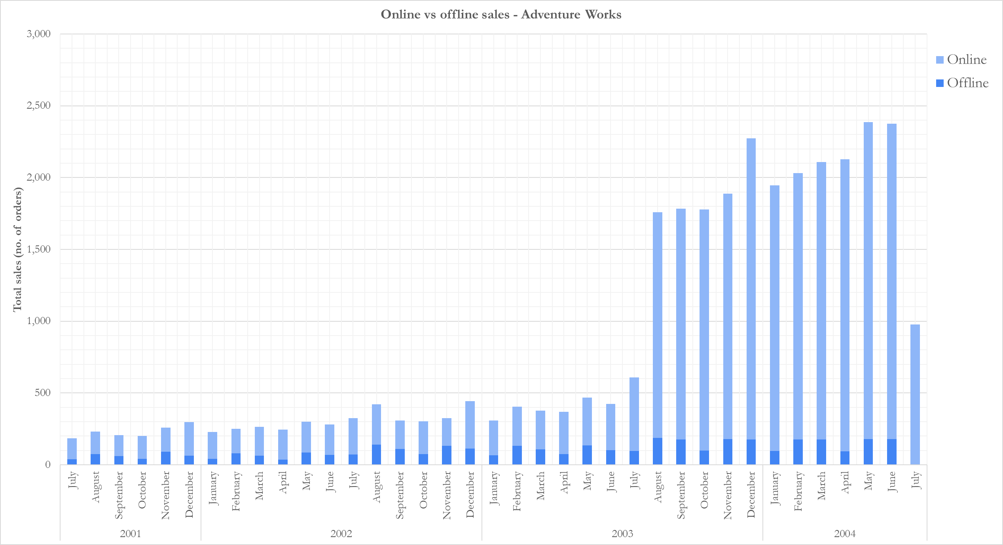
Online sales increased to more than 90% of total sales from August 2003
From July 2001 to July 2003, 74% of sales were online. From August 2003 to June 2004, this jumped to an average of 92%. In July 2004, 100% of sales were online. (As stated before, it is not clear whether July 2004 represents a true picture of the company’s performance in that month, so the data should be treated with caution.)
On average, 74% of sales were online during Phase 1
In Phase 2, this increased to an average of 92%
In Phase 3, 100% of sales were online
Phase 1
Phase 2
Phase 3
Chart 7. Comparison of online and offline sales for all sales in all regions from 2001 to 2004. (Source: Internal data from Adventure Works, 2001-2004.)
James Davies | Introduction to Data Analytics — Sprint 2: Business analysis of Adventure Works
8

Slide 10
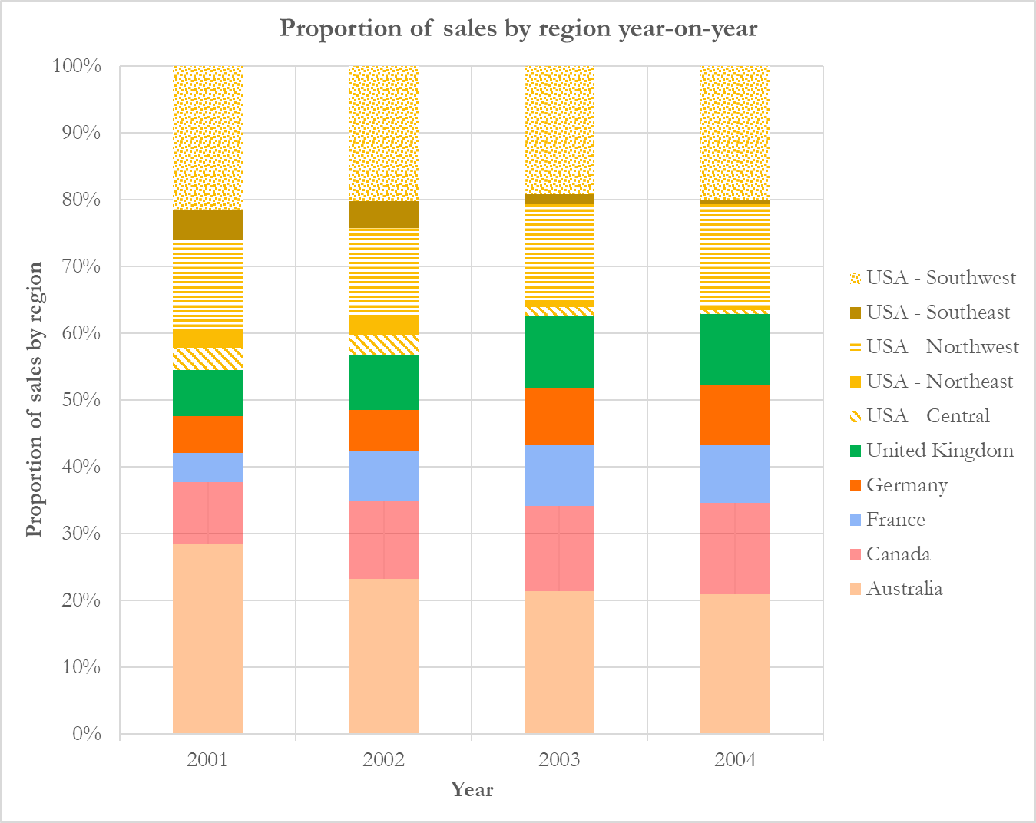
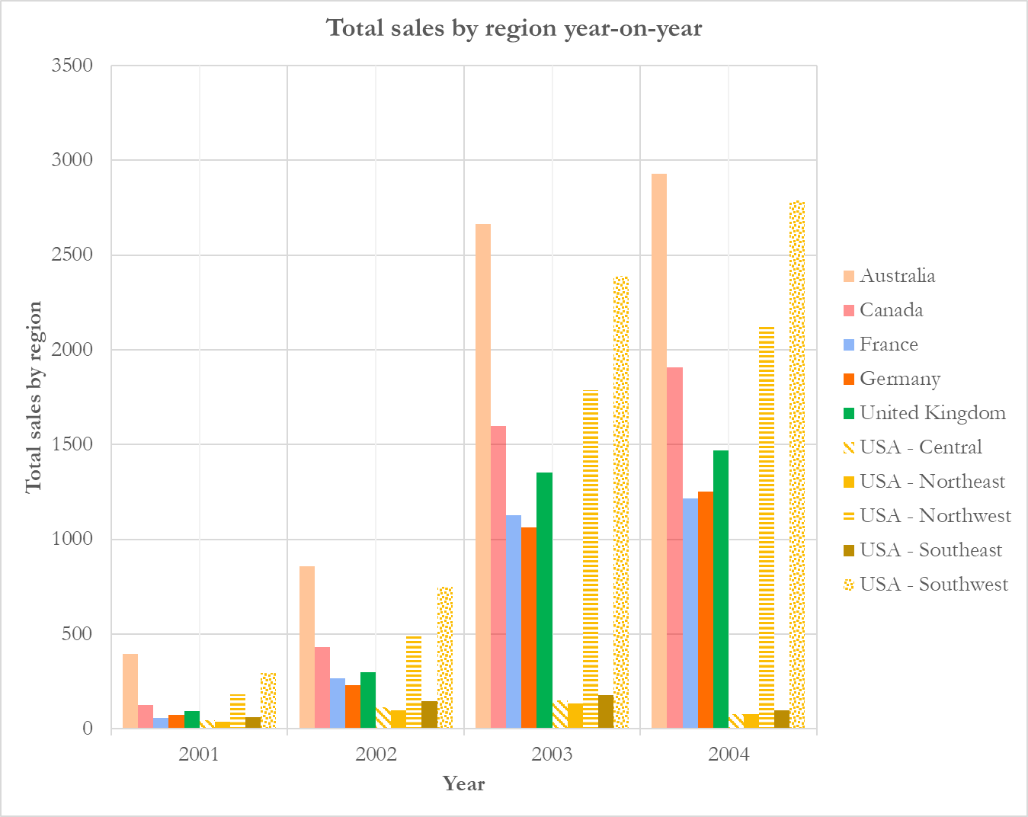
The US is the largest market by volume: ~40% of total sales in 2003 and 2004
United States
Other regions
Chart 8. Proportion of sales from each region year-on-year. Blue lines mark the boundary between US and non-US sales. (Source: Internal data from Adventure Works, 2001-2004.)
Chart 9. Total sales from each region year-on-year. 2001 and 2004 represent July-December and January-July, respectively, so sales in these years are not a reflection of total yearly sales. (Source: Internal data from Adventure Works, 2001-2004.)
Sales from regions other than the United States increased from ~55% in 2001 to ~63% in 2003 and 2004 (see Chart 8). Outside the United States, the most sales consistently came from Australia and Canada (see Chart 9). Within the United States, the Southwest and Northwest regions were responsible for the majority of sales each year.
James Davies | Introduction to Data Analytics — Sprint 2: Business analysis of Adventure Works
9

Slide 11
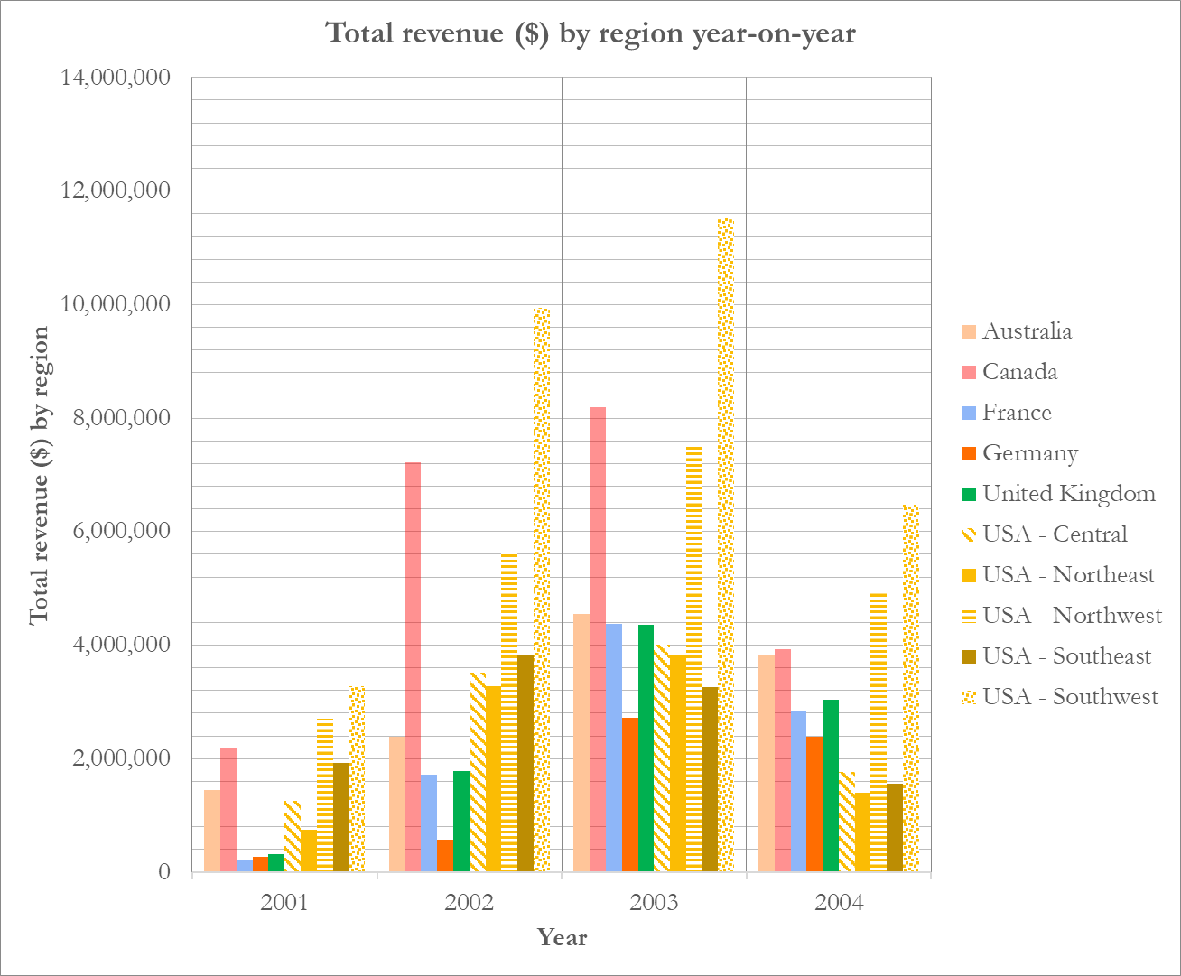
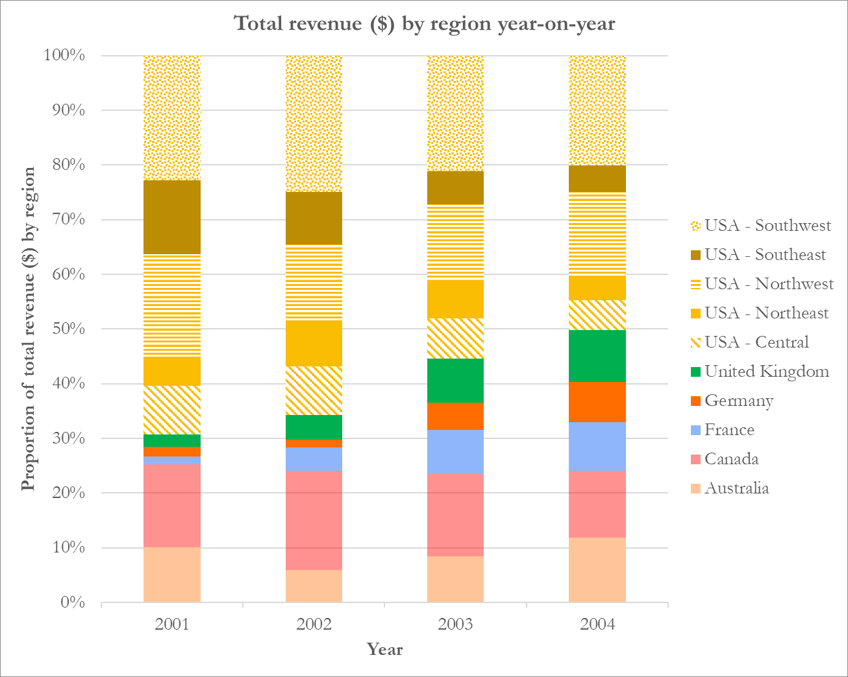
The US is the largest market by revenue: ~50% of total revenue in 2004
The United States was also responsible for the largest share of revenue; the Southwest and Northwest are responsible for the majority of this (see Chart 10), with each region individually bringing in more than any other single country in 2004 (although Canada brought in more revenue than the Northwest region in 2002 and 2003). Outside of the United States, while Australia had the most sales by volume in each year (see Chart 9, previous slide), Canada brought in the most revenue—excluding US regions—in every year (see Chart 10). The share of revenue held by the United States was around 50% in 2004, down from nearly 70% in 2001 (see Chart 11).
United States
Other regions
Chart 10. Total revenue from each region year-on-year. 2001 and 2004 represent July-December and January-July, respectively, so revenue in these years are not a reflection of total yearly revenue. (Source: Internal data from Adventure Works, 2001-2004.)
Chart 11. Proportion of revenue from each region year-on-year. Blue lines mark the boundary between US and non-US revenue. (Source: Internal data from Adventure Works, 2001-2004.)
James Davies | Introduction to Data Analytics — Sprint 2: Business analysis of Adventure Works
10

Slide 12
3
Logistics and human resources

Slide 13
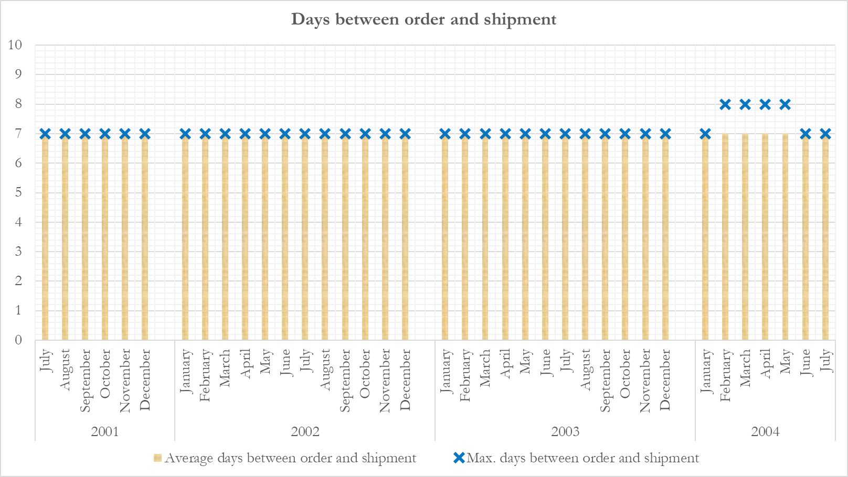
Average delivery time is remarkably consistent over time
In every month from July 2001 to July 2004, the average number of days between order and shipment was seven, and this was the case for every order in all but four months. In each month from February to May 2004, the maximum number of days between order and shipment was eight—only one day above the average.
Chart 12. Average days between the order being placed and the shipment being sent in all regions from 2001 to 2004. Blue crosses represent the maximum days between order and shipment for that month. (Source: Internal data from Adventure Works, 2001-2004.)
James Davies | Introduction to Data Analytics — Sprint 2: Business analysis of Adventure Works
12

Slide 14
Salesperson performance varies considerably
Chart 13. Total sales and total revenue (in $US) for every sales representative across all regions of the company from 2001 to 2004. Gold stars represent highest performing salespeople, while red crosses represent lowest performing salespeople (both arbitrarily decided with heavier weighting on performance from 2003 and 2004). Conditional highlighting of cells applied on a year-by-year basis, rather than over the whole period of data collection. (For example, a person with 23 sales in 2001 is formatted in orange, because the period is only six months and the sales by other salespeople is lower than in later years. In 2003, however, where total sales are higher, a person with 25 sales is formatted in red.) (Source: Internal data from Adventure Works, 2001-2004.)
In every year there was a large disparity between the highest- and lowest-performing salespeople, marked with gold stars and red crosses, respectively. The highest performers consistently made above average sales and revenue (see green cells), while the lowest performers made below average sales and revenues (see red cells) in each year. It is not clear whether the sales figures are linked to performance, or whether factors such as the region the salesperson was responsible for or the product that they were selling were bigger influences on the outcome.
James Davies | Introduction to Data Analytics — Sprint 2: Business analysis of Adventure Works
13

Slide 15
4
Conclusions and recommendations

Slide 16
Adventure Works’ performance can be divided into three phases
In Phase 1, from July 2001 to July 2003, month-on-month sales and revenue are low, reaching peaks of just 609 sales in July 2003 and only ~$US5.5 million in revenue in August 2002. Average revenue ($US) per sale, however, was above $10,000 in 2001 and 2002, and between July 2001 and July 2003 only once fell below $7,000 ($6,372 in July 2001).
In Phase 2, from August 2003 to June 2004, total sales never fell below 1,760—a threefold increase on the peak from Phase 1—while total revenues surpassed US$6 million in five of the eleven months. In fact, nine of the ten highest revenue months occurred in Phase 2. This was achieved through lower prices, with average revenue per sale peaking at US$3,850 (August 2003) and even falling as low as $1,897 in January 2004. This phase coincided with a greater proportion of sales coming from online purchases, up to an average of 92% of all sales in Phase 2, compared with 74% in Phase 1.
In Phase 3, comprising only the month of July 2003, sales and revenue plummeted—the latter by more than 99% to just US$56,179. It is unclear whether these figures reflect the true state of the business, or whether data is missing for the month of July.
In all phases, the largest region in which Adventure Works operates was the United States (at its lowest, in 2004, it brought in ~50% of total revenue). Canada and Australia were also prominent, with a crude estimate of ~15% and 10% of total revenue, respectively.
The company records show a clear distinction between successful and less successful salespeople, with “stars” such as Jae Pak (Canada) and Linda Mitchell (USA – Northwest and Southwest) exchanging the top spot in revenue generated in 2003 and 2004. Surprisingly, although some less successful salespeople may have been victims of regional inactivity, two of the bottom three salespeople were focused on at least one of the four largest regions (USA – Northwest, USA – Southwest, Australia, and Canada). These performances require further investigation.
James Davies | Introduction to Data Analytics — Sprint 2: Business analysis of Adventure Works
15

Slide 17
Recommendations to strengthen the analysis
To determine whether Adventure Works opted to slash its prices or change the type of products it was selling, data about product IDs should be included in the database.
To determine an employee’s performance over time, the start and end date of employment should be included. This would also allow for calculation of average revenue per employee (not just those in sales roles), which could act as a crude, ‘back-of-the-envelope’ proxy for the company’s profitability. (If the average revenue per employee was not significantly above the median US income for 2003/2004, it is likely that the company was not earning enough to make a profit.)
To determine whether Phase 3 (July 2004) was a distinct chapter in the business’ history or just an anomaly caused by missing data, data from August 2004 onwards should be obtained and included.
James Davies | Introduction to Data Analytics — Sprint 2: Business analysis of Adventure Works
16

